Slide 1
WELCOME !!!
Notes:
Hello everyone. Thank you for participating in the experiment. From now on we would like to have your undistracted attention. Do not open any applications on your computer, chat with other students, read, etc. You are about to participate in a study for which you will be paid for your participation in cash.
Please make sure that you do not have any time-keeping devices such as watches, music players or cell phones, with you. You are not allowed to use them at any time during this experiment. If you are seen with such a device you will be asked to leave the experiment and you will forfeit any earnings from participating. If you still have such a device with you now is the last chance to place it in your bag. If you do not have a bag, please let me know so I can keep it safe for you during the experiment.
Does anyone need to place a time keeping device in his or her bag or hand it over to me?
We'd like to remind you that this experiment (or any of the experiments run in this lab) does not contain any deception (lying). The way we describe the experiment and your earnings is the exact way that you will be paid. Your participation is voluntary, and you may leave the room at any time. If you choose to leave the room before the experiment is over, however, you will only be paid the $6 show-up fee. For successfully completing the entire experiment you will be paid an additional $6. On top of the $6 show up payment and the $6 payment for staying until the end of the experiment, you will be able to earn more money depending on the choices you make during the experiment.

Slide 2
Saliva Sample Instructions
1) Unscrew the top of the tube and hold the open tube in your dominant hand.
2) To help generate saliva, you can imagine that you are chewing food moving your jaw up and down as if you were actually eating.
3) After you have generated some saliva, bring the open tube to touching your lips, and release saliva into the tube. Release as much saliva as you can without having to force it too much from your mouth.
4) Repeat steps 2) and 3) until the tube is filled to the black line (not counting any bubbles). It may take up to 5 minutes to fill the tube to the black line.
5) Screw on the top of the tube. If needed, use the napkins provided to you to wipe the outside of the tube. Place the tube in the plastic baggie on the self side of your computer.
Notes:
As part of the experiment, you will be submitting 3 saliva samples. This is a very simple and non-invasive procedure where you basically spit a few times into a tube that is provided to you. This may seem a bit weird, but this procedure is very common and has been performed on thousands of participants.
In order to submit a saliva sample we will give you an empty plastic tube in a plastic bag. Please follow the instructions and submit your first saliva sample at this time.
First unscrew the top of the tube and hold the open tube in your dominant hand.
To help generate saliva, you can imagine that you are chewing food moving your jaw up and down as if you were actually eating.
After you have generated some saliva, bring the open tube to touching your lips, and release saliva into the tube. Release as much saliva as you can without having to force it too much from your mouth.
Repeat until the tube is filled to the black line (not counting any bubbles). It may take up to 5 minutes to fill the tube to the black line.
Screw on the top of the tube. If needed, use the napkins provided to you to wipe the outside of the tube. Place the tube in the plastic bag on the side of your computer.

Slide 3

INTERVAL-TASKS
BOX-TASKS
Notes:
In addition to the $6 show up payment and the $6 payment for staying until the end of the experiment, you will be able to earn money depending on your performance in 2 types of tasks called INTERVAL-TASKS and BOX-TASKS. I’ll explain the details in a bit.

Slide 4
INTERVAL-TASKS
ANNOUNCE
an INTERVAL
WE
SUBMIT
an INTERVAL
YOU
Notes:
Let me explain you first how the INTERVAL-TASKS work. In INTERVAL-TASKS we will announce an interval of time and you will submit an interval of time.

Slide 5
SUBMITTING AN INTERVAL
Start Interval
Announced interval of length T
Mark beginning
End Interval
Announced interval of length T
Mark end
Notes:
Here is how you do to submit an interval. To mark the beginning of an interval you must click on the button “Start Interval”, which is located on the top right corner of the screen. Once you click, the time interval starts and the button now says “End Interval”. If you click on the button again, the time interval ends and the time length between the two clicks is recorded as the submitted time interval.
I will now start the software on your computers so that you can get familiar with the procedure to begin and end a submitted time interval. Please do not touch the mouse until you are told to do so.
Ok. Please go ahead and press the button to mark the beginning of the interval.
[WAIT A FEW SECONDS]
Press the button again to mark the end of the interval.
During the experiment you will have to do several INTERVAL-TASKS. However, only one of them will be picked at random for earning money. I will now explain how you can earn money in an interval task.

Slide 6
INTERVAL-TASKS
60 80 100 120 140
Announced interval
Notes:
The basic idea is that you should submit a time interval that is as close as possible to the announced time interval. For example, imagine that we announce an INTERVAL of 1 minute and 40 seconds, which is 100 seconds.

Slide 7
INTERVAL-TASKS
$20
60 80 100 120 140
Announced interval
Notes:
If you submit an interval of 100 seconds, hitting the bull’s eye, you get $20 dollars.

Slide 8
INTERVAL-TASKS
$19.5
99 101
60 80 100 120 140
Announced interval
Notes:
If you submit an interval that is above or below 100 seconds, you lose some of that money. More precisely, you lose 50 cents for each 1% that your submitted interval is above or below the announced interval.
So, if you submit an interval of 99 seconds or an interval of 101 seconds, you are off by 1% and you get 20 dollars – 50 cents, which is equal to 19 dollars and 50 cents.

Slide 9
INTERVAL-TASKS
$15
90 110
60 80 100 120 140
Announced interval
Notes:
If you submit an interval of 90 seconds or an interval of 110 seconds, you are off by 10% so you get 20 - 5 = 15 dollars.

Slide 10
INTERVAL-TASKS
$10
60 80 100 120 140
Announced interval
Notes:
If you submit an interval of 80 seconds or an interval of 120 seconds, you are off by 20% so you get 20 - 10 = 10 dollars.

Slide 11
INTERVAL-TASKS
$0
60 80 100 120 140
Announced interval
Notes:
Note that if you submit an interval of 60 seconds or less, you are off by 40% or more, and you get nothing.
Similarly, if you submit an interval of 140 seconds or more, you are again off by 40% or more, and you get nothing.

Slide 12
INTERVAL-TASKS
$20
$19.5
$10
$0
-1% +1%
-40% -20% T +20% +40%
Announced interval
Notes:
Summarizing, if we announce an interval of length T and you submit T, you get $20 dollars. Then you lose money depending on how far you are above or below T. It is therefore in your interest to try your best to submit an interval as close as possible to the announced interval T.

Slide 13
BOX-TASK …
Start Interval
End Interval
BOX-TASK …
BOX-TASK
Notes:
Let me now explain you how the other tasks, the BOX-TASKS, work. You will be doing BOX TASKS while you are doing an INTERVAL TASK. So, as explained in this figure, you start an interval for an INTERVAL TASK, then you do a few box tasks, then you end the interval for the INTERVAL TASK.

Slide 14
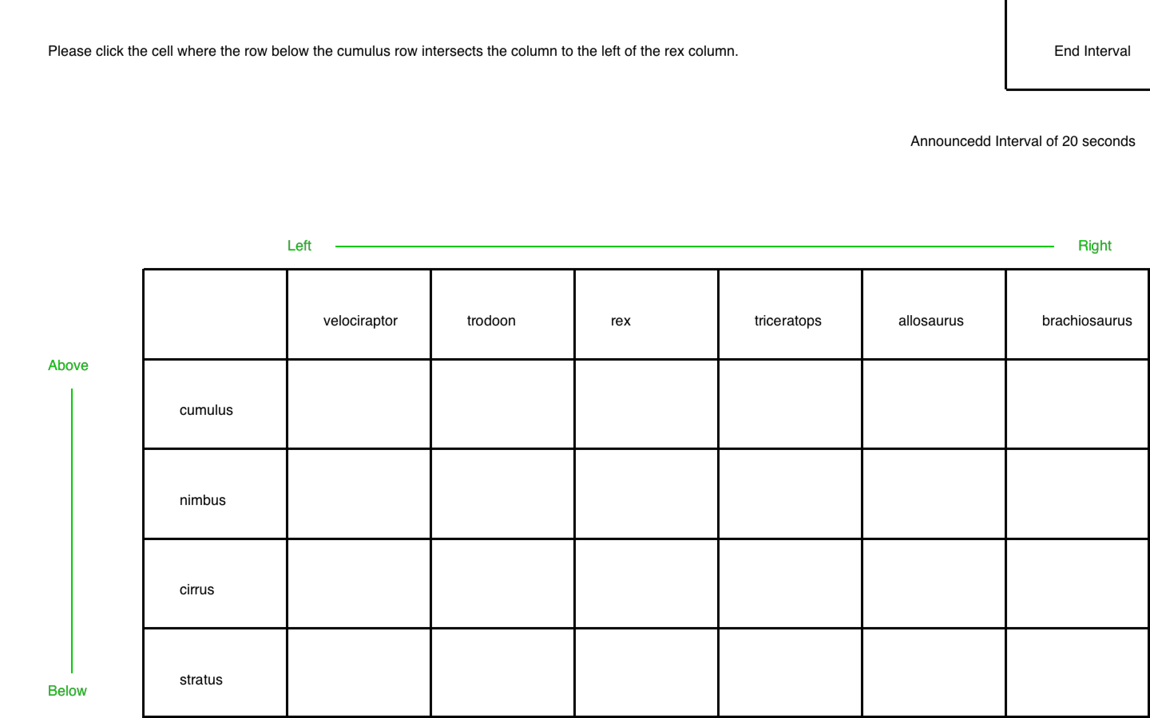
BOX-TASKS
Notes:
While you are doing an INTERVAL TASK, BOX-TASKS will show up on the screen. This is how your screen will look like when a BOX TASK appears. BOX TASKS will always ask you to click on one of the 24 boxes from a table like the one shown in the projector. In this example, BOX TASK rows are labeled with types of clouds and columns are labeled with dinosaurs. In the experiment, these labels will change from BOX TASK to BOX TASK.
In this example, you are asked to click on the BOX where the row below the cumulus row intersects the column to the left of the rex column.
Please click next and answer this box task.
[WAIT A FEW SECONDS]

Slide 15
BOX-TASKS
Notes:
BOX TASKS in the experiment will have a time limit for you to answer. After some time without an answer, the BOX TASK will disappear from the screen and it will count as a wrong answer. The time limit is unknown to you and will vary from BOX TASK to BOX TASK. So make sure to carefully read and click on the correct BOX but don’t take too much time to do so.

Slide 16
BOX-TASK
INTERVAL-TASK
Start Interval
End Interval
BOX-TASK …
BOX-TASK
Notes:
Remember that while you are submitting an interval for an INTERVAL TASK, BOX TASKS will appear one after the other until you click the “End Interval” button. Each BOX TASK will disappear from the screen because you either answered by clicking on a BOX or because you took too long to answer.
Click next and look at this BOX TASK but do not click on any box [WAIT].
This is the approximate amount of time you have to submit an answer. Sometimes a bit more, sometimes a bit less. Now, please try answering two box tasks yourself. Note that if you take too much time to answer, the BOX TASK disappears just like it would in the real trials and it would count as a wrong answer. Use your mouse to click on the “Next” button and answer the 2 BOX TASKS.

Slide 17
BOX-TASK
INTERVAL-TASK
Start Interval
End Interval
BOX-TASK
BOX-TASK …
Notes:
Sometimes a BOX TASK appears almost right after the other and sometimes it takes more time for a BOX-TASK to appear.
You may end a submitted interval either while a BOX-TASK is on your screen or between BOX-TASKS when your screen is blank. You should always answer BOX-TASKS carefully until you feel the length of time of the interval you want to submit has passed. Then you should click on the “End Interval” button regardless of whether you are in a BOX-TASK or in between BOX-TASKS.
Importantly, if you end a time interval during a BOX-TASK (that is, before clicking the box) it will not count either as a correct or as an incorrect answer.

Slide 18
INTERVAL-TASK …
INTERVAL-TASK ..
INTERVAL-TASK …
INTERVAL-TASK
Notes:
The total money you earn depends on your performance in both the INTERVAL TASKS and the BOX TASKS. Even though you will do several INTERVAL TASKS with different announced intervals, only one will count for earning money.

Slide 19
INTERVAL-TASK
INTERVAL-TASK
INTERVAL-TASK
INTERVAL-TASK
Notes:
Indeed, at the end of the experiment we will use this bingo cage to randomly pick one TIME INTERVAL and that randomly picked time interval will be the TIME-INTERVAL-THAT-COUNTS.
It is key that you treat carefully all intervals, as any of them could be picked to be the TIME-INTERVAL-THAT-COUNTS

Slide 20
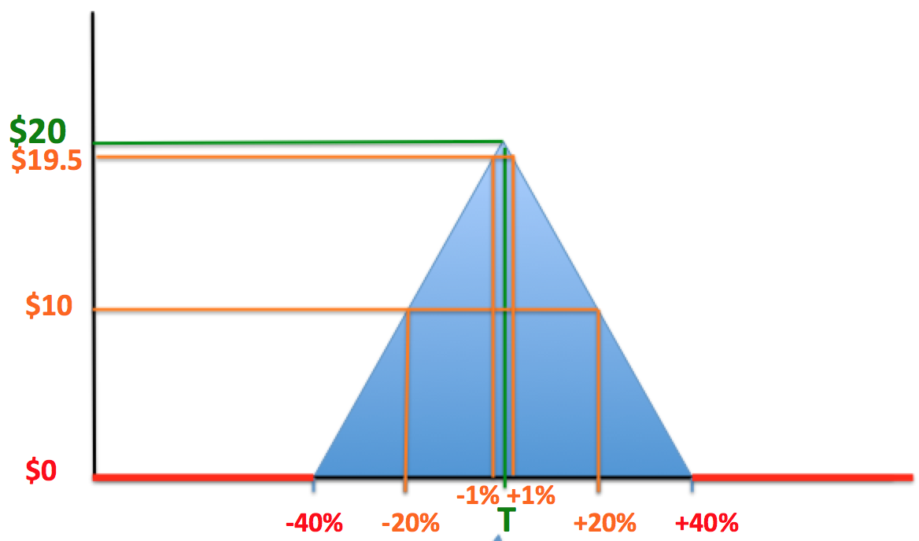
For the TIME-INTERVAL-THAT-COUNTS you get:
< 75% BOX-TASKS correct
→ NO PAYMENT
≥ 75% BOX-TASKS correct
→ PAYMENT FOR THAT INTERVAL TASK AS EXPLAINED BEFORE
Notes:
Your total payoff in this section will be computed as follows.
Consider an INTERVAL TASK and suppose that this is the one picked at the end by the bingo cage as the TIME-INTERVAL-THAT-COUNTS.
If you answer correctly less than 75% of BOX TASKS within that INTERVAL TASK then you do not earn any money independently of how well you do with your submitted interval.
If you answer correctly 75% or more of BOX TASKS within that INTERVAL TASK then you earn money depending on the announced interval and the submitted interval in that INTERVAL TASK, just as explained before. (POINT AT THE TRIANGLE)
Are there any questions?
Ok. Let’s do some practice tasks. These are identical to what you will see in the real experiment, except that they do not count for your payment. The purpose is to familiarize yourself with the software and procedures.
[Wait for 2 INTERVAL TASKS OF 20 and 16 SECONDS]
Is everything clear?

Slide 21
CPT
Notes:
For this part of the experiment you will need to place your left hand in a bucket of ice water with your fingers spread open. It is very important that you leave your hand in the water as long as you possibly can. There is a required minimum amount of time that you need to keep your hand in the water in order to continue with the experiment. If you do not keep your hand in the water for a long enough time to satisfy the minimum requirement you will be asked to leave the experiment with only your $6 show-up-fee. You only have one opportunity to keep your hand in the water for a long enough time to pass the minimum threshold. I will announce when everyone can take their hand out of the water. If for some reason you need to remove your hand before I make the announcement please wait silently.
Also, we need to analyze and videotape your facial expressions during this task. It is important that you look directly into the camera for the entire time your hand is in the water.
Please remove all jewelry on your left hand and arm. The lab assistants are setting up a bucket of ice water for each of you and will be placing an elastic band on your left wrist above your wrist bone. Keeping your hand in the water means keeping the elastic band submerged underneath the water. Your time stops if your hand comes out of the water enough so that the elastic band is no longer under the water. The lab assistants will be watching the elastic band along with your video recording. Also, your fingers need to remain spread during the whole time your hand is in the water.
When everyone is ready to proceed I will instruct everyone to begin. When I say “Begin” put your hand in the bucket of ice water and look directly into the camera. At this point the timer will be started and you will be told when you can take your hand out of the bucket. Your time stops if you close your hand into a fist or if you remove your hand from the water such that the elastic band is no longer submerged.
If you feel it necessary, please adjust your seat by using the lever on the right side of your chair. Is everyone ready?

Slide 22
WE WILL NOW BEGIN
Notes:
We will now begin the real trials.

Slide 23
SECTION 2
Notes:
You have completed Section 1. The TIME-INTERVAL-THAT-COUNTS for Section 1 will be randomly picked at the end of the experiment.
We will now explain how Section 2 works.
Section 2 is identical to Section 1, except for ONE important difference, which is how you make money with the submitted interval. All the rest is exactly the same as before.

Slide 24
INTERVAL-TASKS
$20
$0
60 80 100 120 140
Announced interval
Notes:
In Section 2, if you submit a time interval that is above the announced time interval you get nothing. If you submit a time interval that is below the announced time interval you get the same payment as in section 1. This means that you have to be very careful to not click the “end interval” button after the announced interval T has passed.
So, imagine for example that we announce an INTERVAL of 100 seconds. If you submit an interval greater than 100 seconds you get nothing.
If you submit an interval of exactly 100 seconds, you get 20 dollars. Then you get subtracted 50 cents for each 1% below the announced interval of 100 seconds.

Slide 25
INTERVAL-TASKS
$19.5
$0
99 101
60 80 100 120 140
Announced interval
Notes:
So if you submit an interval of 99 seconds, you are below the announced interval by 1% so you get 20 dollars – 50 cents = 19.5 dollars.
But if you submit an interval of 101 seconds, you get nothing.

Slide 26
INTERVAL-TASKS
$15
$0
90 110
60 80 100 120 140
Announced interval
Notes:
If you submit an interval of 90 seconds, you are below the announced interval by 10% so you get 20 – 5 = 15 dollars.
But if you submit an interval of 110 seconds, you are above the announced interval by 10%, so you get nothing.

Slide 27
INTERVAL-TASKS
$10
$0
60 80 100 120 140
Announced interval
Notes:
If you submit an interval of 80 seconds, you are below the announced interval by 20% so you get 20 – 10 = 10 dollars.
But if you submit an interval of 120 seconds, you get nothing.

Slide 28
INTERVAL-TASKS
$10
$0
60 80 100 120 140
Announced interval
Notes:
Finally, if you submit an interval of 60 seconds or less, you are below the announced interval by 40% or more, and you get nothing.
If you submit an interval of 140 seconds or more, you also get nothing.

Slide 29
INTERVAL-TASKS
$20
$19.5
$10
$0
-1% +1%
-40% -20% T +20% +40%
Announced interval
Notes:
Summarizing, if we announce an interval of length T and you submit T, you get $20 dollars. Then you lose some money for submitting an interval that is below the announced interval T. If you submit an interval that is above T by any amount you earn nothing. It is therefore in your best interest to not click the “end interval” button after the announced interval T has passed.

Slide 30
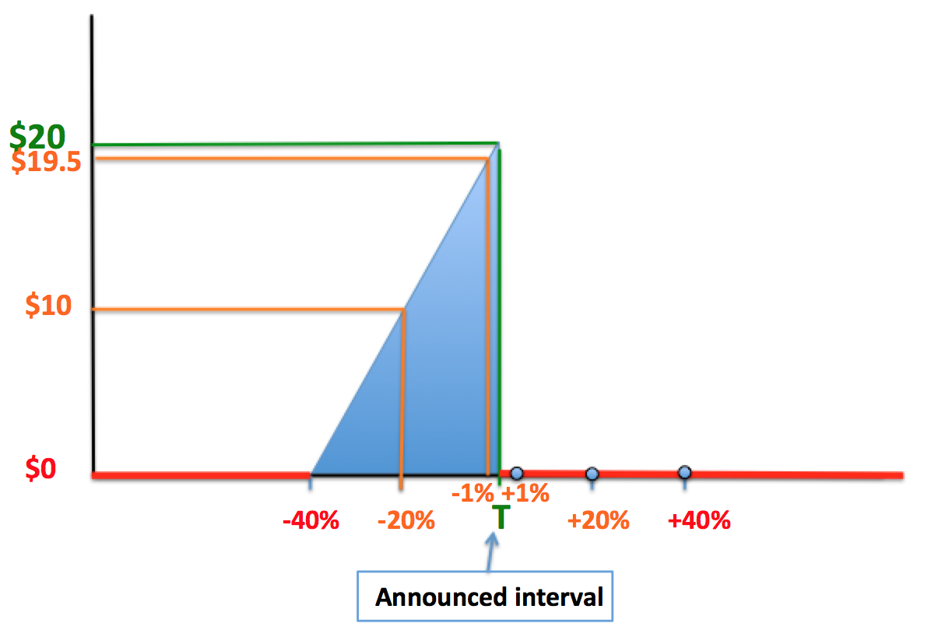
If in the TIME-INTERVAL-THAT-COUNTS you get:
< 75% BOX-TASKS correct
→ NO PAYMENT
≥ 75% BOX-TASKS correct
→ PAYMENT FOR THAT INTERVAL TASK AS EXPLAINED BEFORE
Notes:
All the rest is exactly the same as in section 1: you will be doing box tasks during the interval tasks, you will have to answer at least 75% of box tasks correctly to earn any payment, we will use the bingo cage to draw one time interval to be the time-interval that counts, etc.
Are there any questions?

Slide 31
Saliva Sample Instructions
1) Unscrew the top of the tube and hold the open tube in your dominant hand.
2) To help generate saliva, you can imagine that you are chewing food moving your jaw up and down as if you were actually eating.
3) After you have generated some saliva, bring the open tube to touching your lips, and release saliva into the tube. Release as much saliva as you can without having to force it too much from your mouth.
4) Repeat steps 2) and 3) until the tube is filled to the black line (not counting any bubbles). It may take up to 5 minutes to fill the tube to the black line.
5) Screw on the top of the tube. If needed, use the napkins provided to you to wipe the outside of the tube. Place the tube in the plastic baggie on the self side of your computer.
Notes:
Before we begin the real trials you will be submitting saliva sample #2. In order to submit a saliva sample we will give you a second empty plastic tube in a plastic bag. Please follow the same instructions as before and submit the second saliva sample at this time.
Again, first unscrew the top of the tube and hold the open tube in your dominant hand.
To help generate saliva, you can imagine that you are chewing food moving your jaw up and down as if you were actually eating.
After you have generated some saliva, bring the open tube to touching your lips, and release saliva into the tube. Release as much saliva as you can without having to force it too much from your mouth.
Repeat until the tube is filled to the black line (not counting any bubbles). It may take up to 5 minutes to fill the tube to the black line.
Screw on the top of the tube. If needed, use the napkins provided to you to wipe the outside of the tube. Place the tube in the plastic bag on the self side of your computer.

Slide 32
WE WILL NOW BEGIN
Notes:
We will now begin the real trials for section 2.

Slide 33
SECTION 3
Notes:
You have completed Section 2. The TIME-INTERVAL-THAT-COUNTS for Section 2 will be randomly picked at the end of the experiment.
We will now explain how Section 3 works.
Section 3 is identical to Sections 1 and 2, except once again for the way you make money with the submitted interval.

Slide 34
INTERVAL-TASKS
$20
$0
60 80 100 120 140
Announced interval
Notes:
In Section 3, if you submit a time interval that is below the announced time interval you get nothing. If you submit a time interval that is above the announced time interval you get the same payment as in section 1. This means that you have to be very careful to not click the “end interval” button before the announced time interval T has passed.
So, imagine for example that we announce an INTERVAL of 100 seconds. If you submit an interval smaller than 100 seconds you get nothing.
If you submit an interval of exactly 100 seconds, you get 20 dollars. Then you get subtracted 50 cents for each 1% above the announced interval of 100 seconds.

Slide 35
INTERVAL-TASKS
$19.5
$0
99 101
60 80 100 120 140
Announced interval
Notes:
So if you submit an interval of 101 seconds, you get 19.5 dollars.
But if you submit an interval of 99 seconds, you get nothing.

Slide 36
INTERVAL-TASKS
$15
$0
90 110
60 80 100 120 140
Announced interval
Notes:
If you submit an interval of 110 seconds you get 15 dollars.
But if you submit an interval of 90 seconds, you get nothing.

Slide 37
INTERVAL-TASKS
$10
$0
60 80 100 120 140
Announced interval
Notes:
If you submit an interval of 120 seconds, you get 10 dollars.
But if you submit an interval of 80 seconds, you get nothing.

Slide 38
INTERVAL-TASKS
$10
$0
60 80 100 120 140
Announced interval
Notes:
Finally, if you submit an interval of 140 seconds or more, you get nothing and if you submit an interval of 60 seconds or less, you also get nothing.

Slide 39
INTERVAL-TASKS
$20
$19.5
$10
$0
-1% +1%
-40% -20% T +20% +40%
Announced interval
Notes:
Summarizing, if we announce an interval of length T and you submit T, you get $20 dollars. Then you lose some money for submitting and interval that is above the announced interval T. If you submit an interval that is below T by any amount you earn nothing. It is therefore in your best interest to not click the “end interval” button before the announced interval T has passed.

Slide 40
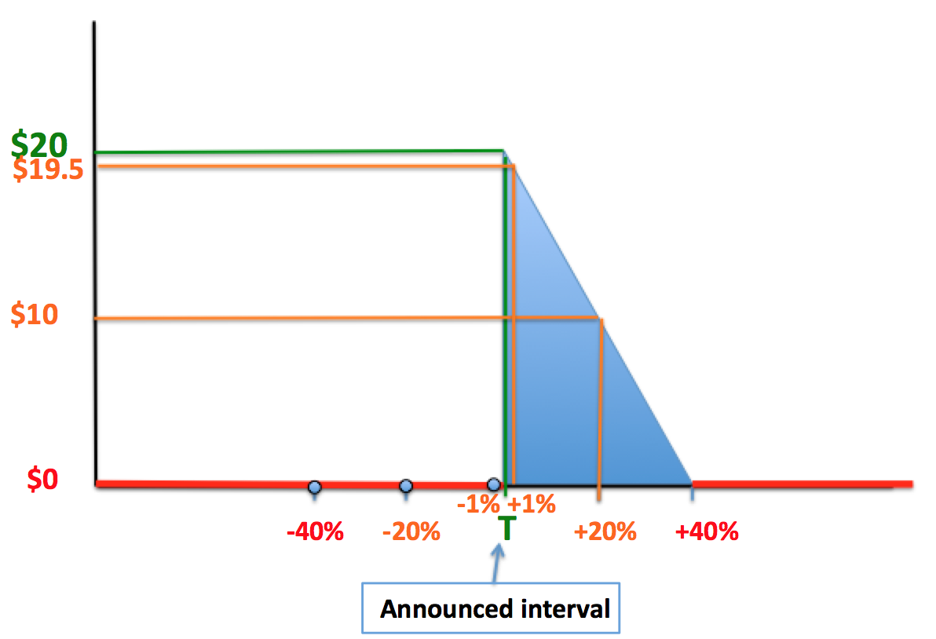
If in the TIME-INTERVAL-THAT-COUNTS you get:
< 75% BOX-TASKS correct
→ NO PAYMENT
≥ 75% BOX-TASKS correct
→ PAYMENT FOR THAT INTERVAL TASK AS EXPLAINED BEFORE
Notes:
All the rest is exactly the same as in sections 1 and 2: you will be doing box tasks during the interval tasks, you will have to answer at least 75% of box tasks correctly to earn any payment, we will use the bingo cage to draw one time interval to be the time-interval that counts, etc.
Are there any questions?

Slide 41
WE WILL NOW BEGIN
Notes:
We will now begin the real trials for section 3.

Slide 42
Saliva Sample Instructions
1) Unscrew the top of the tube and hold the open tube in your dominant hand.
2) To help generate saliva, you can imagine that you are chewing food moving your jaw up and down as if you were actually eating.
3) After you have generated some saliva, bring the open tube to touching your lips, and release saliva into the tube. Release as much saliva as you can without having to force it too much from your mouth.
4) Repeat steps 2) and 3) until the tube is filled to the black line (not counting any bubbles). It may take up to 5 minutes to fill the tube to the black line.
5) Screw on the top of the tube. If needed, use the napkins provided to you to wipe the outside of the tube. Place the tube in the plastic baggie on the self side of your computer.
Notes:
You have completed section 3. You will now submit the third and last saliva sample. In order to submit a saliva sample we will give you a third empty plastic tube in a plastic bag. Please follow the same instructions as before and submit the third saliva sample at this time.
Again, first unscrew the top of the tube and hold the open tube in your dominant hand.
To help generate saliva, you can imagine that you are chewing food moving your jaw up and down as if you were actually eating.
After you have generated some saliva, bring the open tube to touching your lips, and release saliva into the tube. Release as much saliva as you can without having to force it too much from your mouth.
Repeat until the tube is filled to the black line (not counting any bubbles). It may take up to 5 minutes to fill the tube to the black line.
Screw on the top of the tube. If needed, use the napkins provided to you to wipe the outside of the tube. Place the tube in the plastic bag on the self side of your computer.

